Slide 1


Customer Churn
Prediction
System
NovaByte
Analytics
With Behavioral Analysis | Data Science Project
PRESENTED BY
Gadi Poojitha Sharini
2025
2303A54011
Project
Anjali shinde
2303A54037

Slide 2
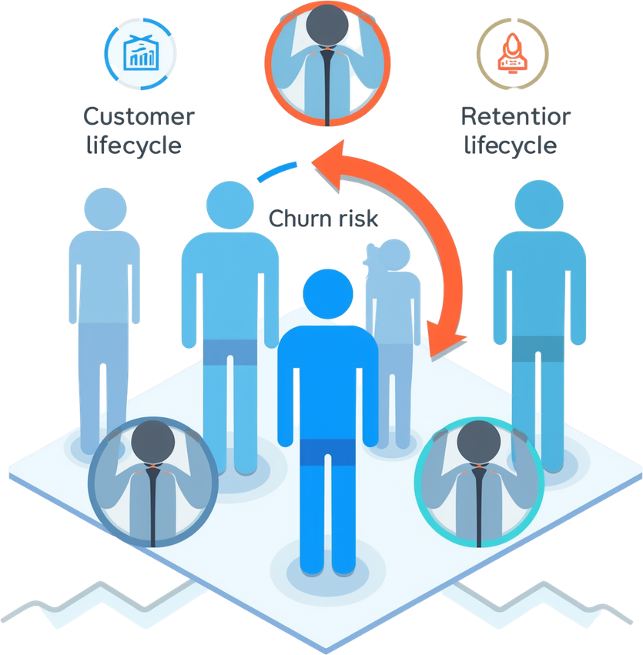
02
Introduction
UNDERSTANDING CUSTOMER CHURN AND ITS BUSINESS IMPACT
What is customer churn?
Customer churn refers to when customers stop doing business with a company, representing lost revenue and growth potential.
Why predicting churn matters
Early identification enables proactive retention strategies, reducing acquisition costs and maximizing customer lifetime value.
Real-world business impact
Churn directly affects revenue streams, market share, and long-term sustainability across all industries.
Behavioral analysis enhancement
Our advanced system leverages behavioral patterns to detect early warning signals and enable timely interventions.

Slide 3


03
Objectives
MAIN PROJECT GOALS & DELIVERABLES
Predict customer churn using machine learning algorithms and historical data patterns.
Analyze behavioral evolution over time to identify changing customer engagement trends.
Detect early churn risk signals through proactive monitoring and alert systems.
Simulate intervention impact scenarios and provide explainable insights for decisions.

Slide 4
04
Stakeholders
KEY ROLES IN THE CHURN PREDICTION PROJECT
01
02
03
04
CEO & HEAD OF PROJECT
PROJECT GUIDE
DATA ANALYST
END USERS
Poojitha Sharini and Anjali Shinde– Strategic leadership and project oversight
Supervisor providing mentorship and technical guidance
Model support and data processing expertise
Application users benefiting from churn insights

Slide 5
05
Programming Languages, Tools & Software
TECH STACK POWERING THE CHURN PREDICTION SYSTEM
01
02
03
04
PANDAS & NUMPY
PYTHON
FLASK
SCIKIT-LEARN
Core programming language for ML model development and data processing
Lightweight web framework for deploying the prediction API
Machine learning library for building churn prediction models
Data manipulation and numerical computing libraries

Slide 6

06
Prompts Used to Generate Code
ML Model Prompt
01
"Build a churn prediction model using behavioral features"
02
Flask App Prompt
"Create a Flask web app for ML prediction with REST API endpoints"
SAMPLE AI PROMPTS USED TO GENERATE SYSTEM COMPONENTS
Frontend UI Prompt
03
These AI-generated prompts were used to accelerate development of the Customer Churn Prediction System. Each prompt was carefully crafted to generate specific components of the machine learning pipeline, web application framework, and user interface elements. The structured approach enabled rapid prototyping while maintaining code quality and consistency across the entire project architecture.
"Generate frontend UI for prediction dashboard with input forms"
04
Simulation Prompt
"Implement intervention impact simulation logic for churn analysis"

Slide 7
07
Workflow Flowchart
DATA-TO-APPLICATION PIPELINE OVERVIEW
02
04
DATA
COLLECTION
FEATURE ENGINEERING
Gather customer data from CRM, transactions, and behavioral logs.
Extract behavioral patterns and create predictive features.
MODEL & WEB APP
DATA PREPROCESSING
Train ML model, generate predictions, deploy via Flask application.
01
03
Clean, normalize, and transform raw data for analysis.

Slide 8
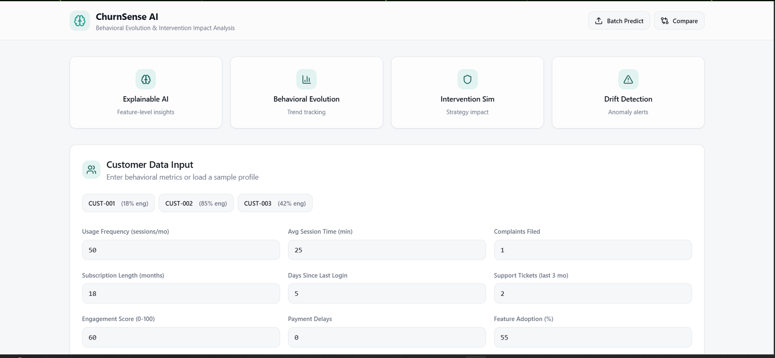
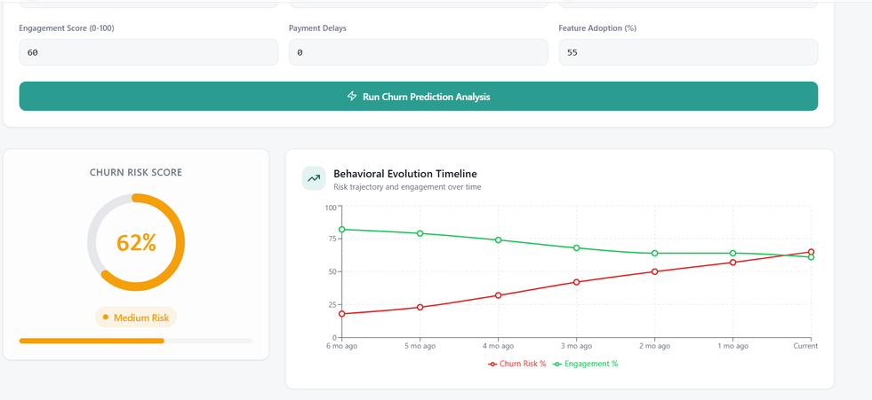
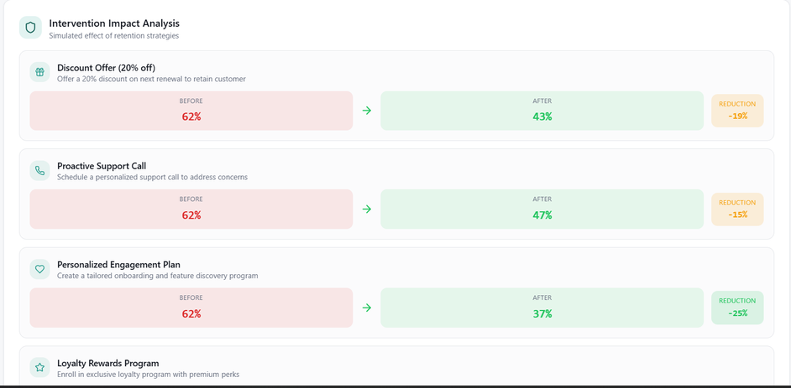
08
Frontend
View
INTERACTIVE DASHBOARD FOR CHURN PREDICTION AND INTERVENTION ANALYSIS
The user interface features a clean input form capturing customer data fields including demographics, usage patterns, and behavioral metrics. The output dashboard displays churn probability percentage with color-coded risk levels, behavioral trend insights over time, and interactive intervention effect simulations. Users can explore how different retention strategies impact predicted outcomes in real-time.
62%
Churn probability displayed in dashboard

Slide 9
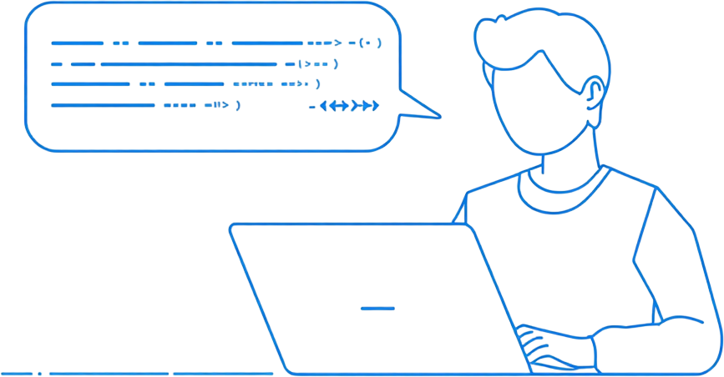
09
Proof of Prompts
PROMPT → CODE GENERATION EXAMPLES
"Build a churn prediction model using behavioral features"
→ Generated: Random Forest classifier with feature importance
"Create a Flask web app for ML prediction"
→ Generated: RESTful API endpoints with model integration
"Generate frontend UI for prediction dashboard"
→ Generated: HTML/CSS forms with result display
"Implement intervention impact simulation logic"
→ Generated: Scenario analysis functions with probability adjustments

Slide 10
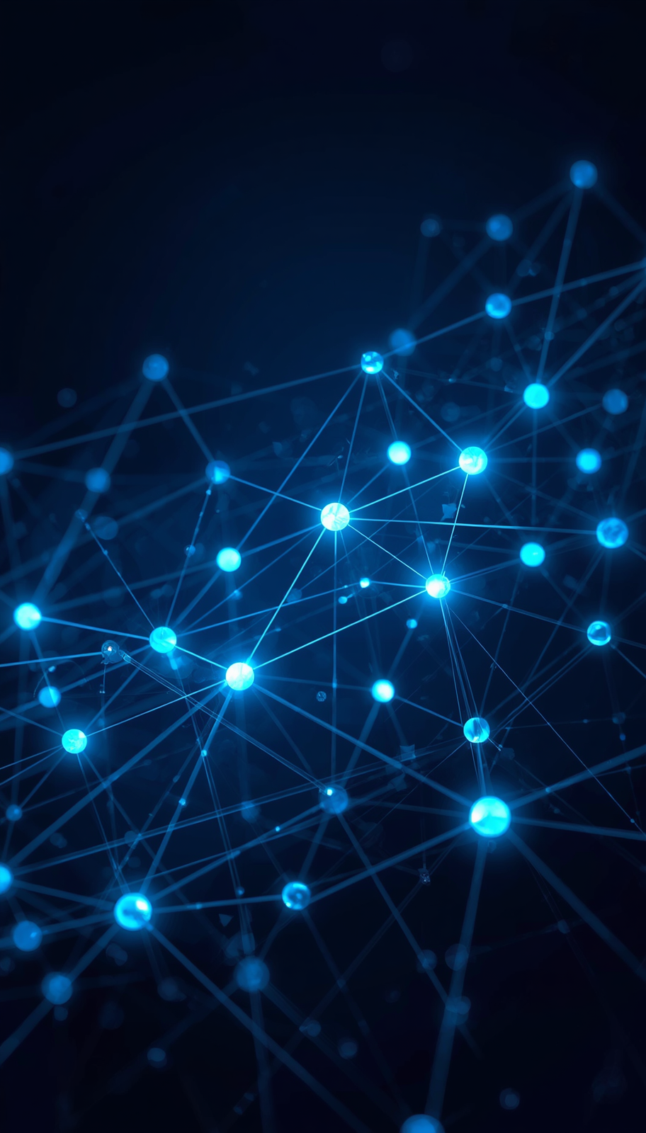

Thank You!
References &
Key Resources
NovaByte
Analytics
• scikit-learn documentation
• Flask documentation
• Kaggle datasets
• Python official documentation
10
of 10

